Slide 1





Case Study
Audience
Sale Department
Type of Analysis
Reduce returned products
Increase Revenue
Context
Which product/market should we focus on to improve revenue?
Which product/market needs improvement to reduce the return ratio?
Aha Moment
Focus on key products/ markets could drive an incremental $55M

Slide 2

Data
Storytelling
There is a significant opportunity to reduce the number of product returns and increase revenue

Slide 3
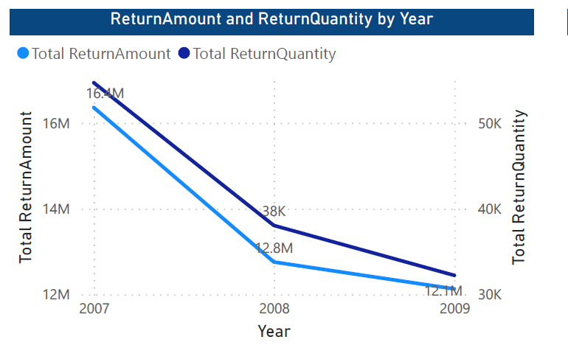
Overall Return Amount over 3 years
The line chart shows a general downward trend in the number of returned goods over a period of three years. The steepest decline occurred 2007-2008, with a decrease of 20%. In the following year, 2008-2009, the decrease was less pronounced, with a reduction of 4.17%.

Slide 4
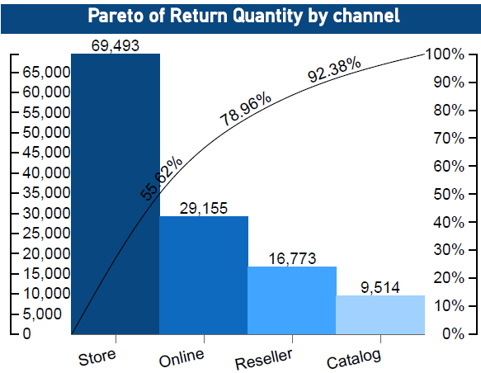
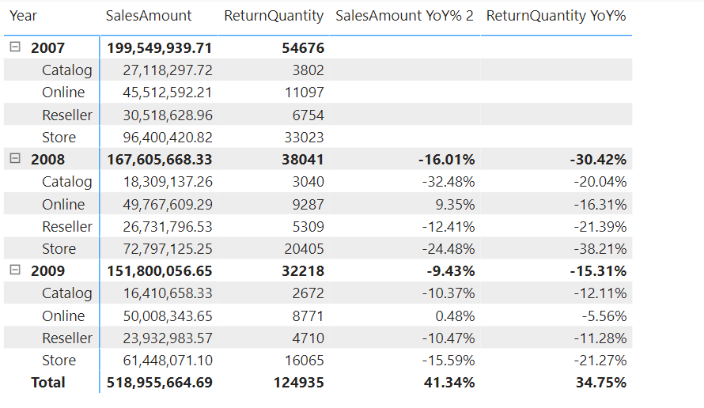
Return Quantity increased at Store
Store has the highest return rate , but it is also the top revenue-generating source. The optimistic aspect is that the return rate has decreased gradually over the years.
Online sales are generating increasing revenue and have a significantly lower return rate compared to store sales. ==> If the ratio of increased sales and decreased returned product is the same as in 2009, the sales in 2010 will increase by 34.3M
Catalog and reseller sales also have a decreasing return rate over the years, but their revenue has decreased.

Slide 5
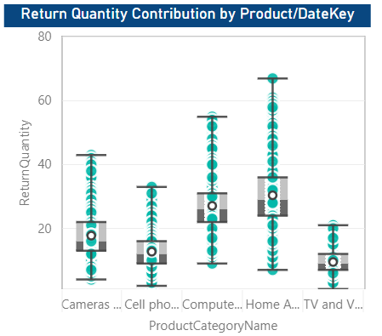
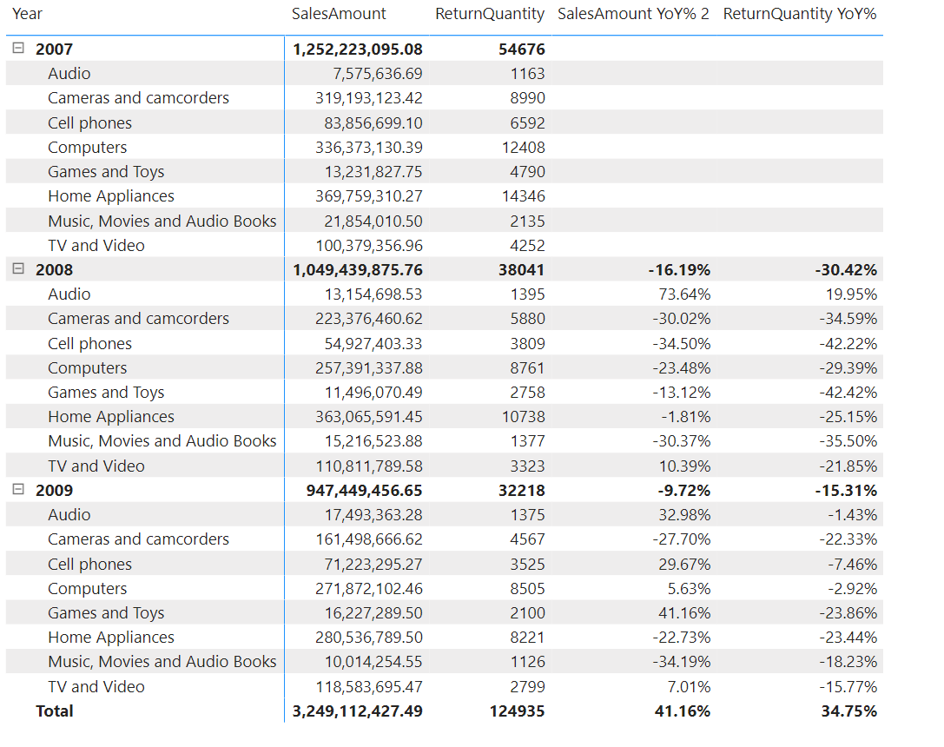
Home appliances caused the increase in return quantity
Home appliances have the highest return rate, but they are also the products that generate the highest revenue (31.2%) for the company
TV and video have a decreasing ratio of product returns and an increasing revenue trend each year. With such a ratio, the sales are predicted to increase 8.35M in 2010

Slide 6
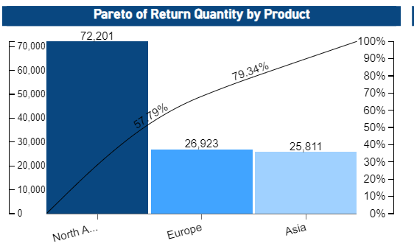
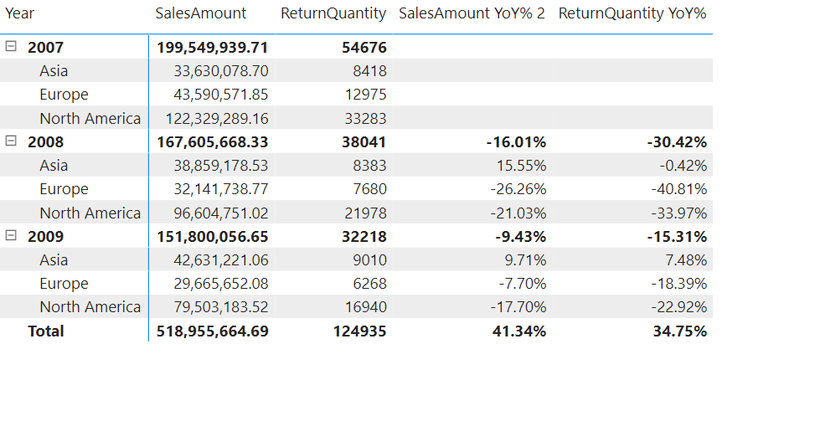
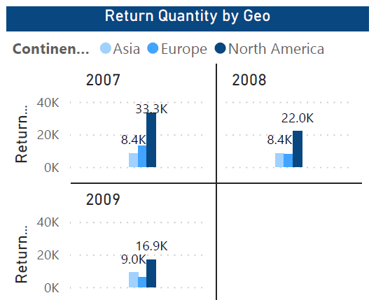
Return Quantity increased at NA (EU, ASIA)
In 2007, NA had three times the revenue of Asia, but the gap gradually narrowed. By 2009, NA =2 times revenue of Asia and 3 times that of Europe the return rate
Asia's revenue has been increasing steadily, but the return rate has been relatively stable==> revenue is predicted to increase 4.14M in 2010

Slide 7
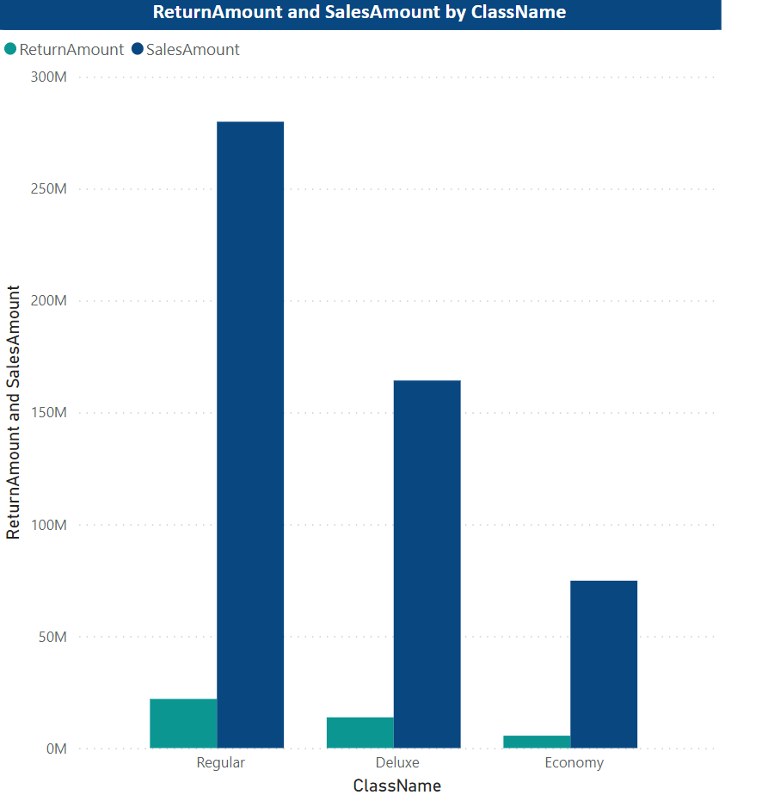
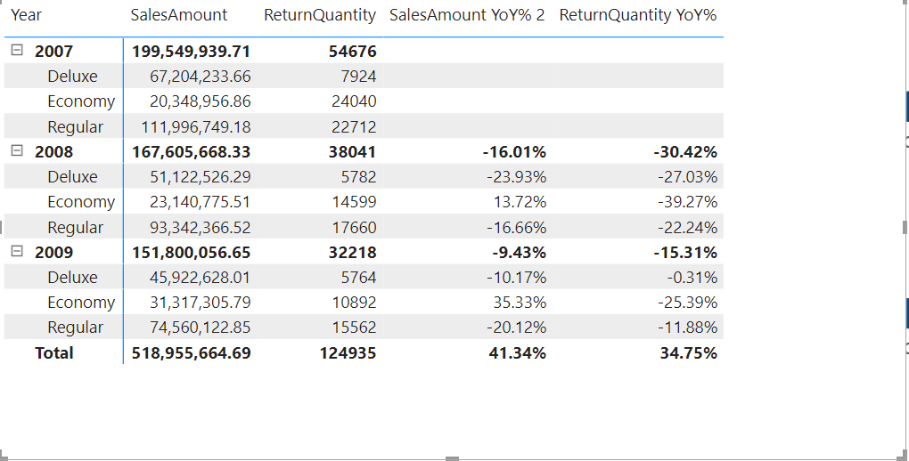
Classname (Regular) caused the increase in return quantity
Regular has the highest product return ratio, and although this number decreases each year, the revenue is also significantly affected
Economy has a decreasing ratio of product returns and an increasing revenue trend each year. With such a ratio, the predicted revenue for 2010 will increase 8.2M

Slide 8
AHA MOMENT
$55.000.000
Focusing on the main factors will help increase the revenue and reduced returned rate in 2010 [Refer to Appendix 1 (Rising Insights)]

Slide 9
Solutions and Next Steps
Improve product quality, especially home appliance. Promote Marketing for TV+Video
Increase training for store employees: By providing additional training to store employees on the features 🡺 can reduce the number of returns resulting from customer confusion or dissatisfaction.
3. Accelerate business in Asia, and reevaluate NA business strategies if you want revenue to increase and return rates to decrease
4. Focus more on Economy items, suitable for most consumers

Slide 10
Appendix 1: Data Storytelling Framework
01
Aha Momment
Focus on right key dimensions could drive an incremental $55M in total revenue in 2010
03
Hook & Setting
Overall, Return Quantity dropped YoY because of
decreasing of number of Transaction & Sale Quantity
(Setting) but not all markets & products decreased.
Rising Insights
1) Transaction: # Online Transactions is + 34.3M with low returned ratio
(2) Quantity: During an economic downturn, customers tend to buy large quantities/ transaction of low-cost products (Economy): +8.2M
(3) Geo: Revenue in Asia: +4.14M
(4) Product: TV + Video: +8.35M
Push marketing at Asia (Asia region is less affected by economic recession so we could strengthen the Asian market.
Increase marketing for TV+ Video products, which have consistently low return ratios and steadily increasing transactions each year.
Push Upsell Strategy for Economy at all continents
4) Focus on online sales channels and increase marketing efforts to drive sales and revenue through this channel.
5) Offer better customer service: business can address customer concerns and issues before they lead to returns, + provide guidance throughout the return process.
02
04

Slide 11
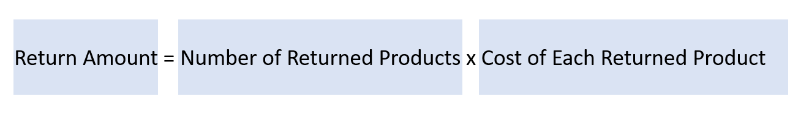
Appendix 2: Reduce Return Quantity and Return Amount by Customer
We can reduce the number of product returns by improving customer service and providing clear product specifications.

Slide 12

THANK YOU

